Slide 1
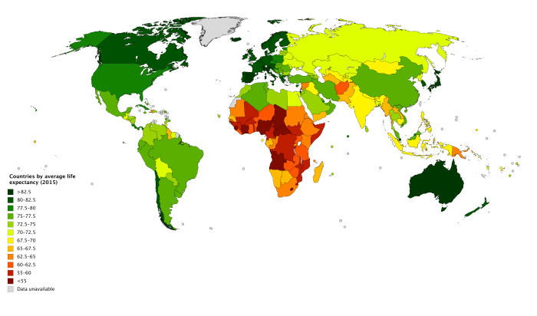

“Don’t get AIDS”: Making inferences about life expectancy
By Aaron Chumsky,
Alex Jordan, Tianke Li, Sam Ressin, and
Litian Zhou

Slide 2


Problem Overview
Problem: What factors contribute most to a nation’s average life expectancy?
Response: Life expectancy (measured in average years)
Goal of the project: two pronged approach:
Individuals
Governments
Why this problem right now?

Slide 3

Our Data
193 countries, years 2000-2015
21 predictors, 1 response (life expectancy)
Missing data: only in certain variables
Full dataset: 2,938 observations
Without missing data: 1,649 observations
Categories of predictors:
Mortality: deaths of age groups
Public health: vaccination rates, health, diseases
Socio-economic factors: dev’t status, population

Slide 4
Our methods
Permutation
Linear Regression
Variable Selection
Regularization
Dimensionality Reduction
Non-linear Regression
Tree Based Methods

Slide 5
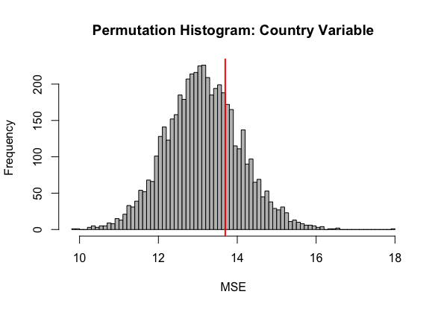
Permutation on Country
MSE of linear model,
permuting Country variable
5000 permutations of three variables to test for significance:
Country: 0.270 = p > alpha = 0.05
Original Test MSE: 13.78
Year: [1]p = 0.278, [2]p = 0.337)
Original Test MSE: 13.55
Status: [1]p = 0.305, [2]p = 0.306)
Original Test MSE: 13.69
Notes:
The Country variable, given all other variables does not do a better job of explaining the response, Life Expectancy.

Slide 6
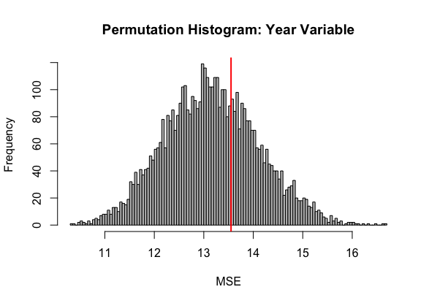
Permutation on Year
MSE of linear model,
permuting Country variable
5000 permutations of three variables to test for significance:
Country: 0.270 = p > alpha = 0.05
Original Test MSE: 13.78
Year: [1]p = 0.278, [2]p = 0.337)
Original Test MSE: 13.55
Status: [1]p = 0.305, [2]p = 0.306)
Original Test MSE: 13.69
Notes:
The Year variable, given all other variables does not do a better job of explaining the response, Life Expectancy.

Slide 7
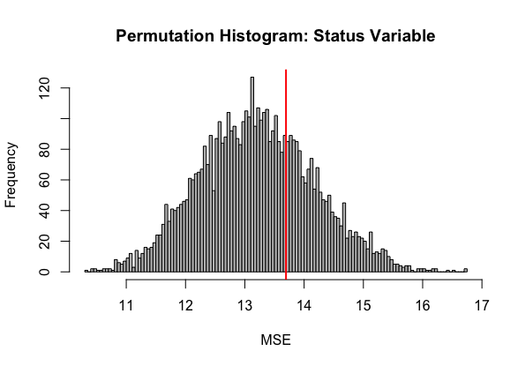
Permutation on Country Status (Developed or developing)
MSE of linear model,
permuting Country variable
5000 permutations of three variables to test for significance:
Country: 0.270 = p > alpha = 0.05
Original Test MSE: 13.78
Year: [1]p = 0.278, [2]p = 0.337)
Original Test MSE: 13.55
Status: [1]p = 0.305, [2]p = 0.306)
Original Test MSE: 13.69
Notes:
The Status variable, given all other variables does not do a better job of explaining the response, Life Expectancy.

Slide 8
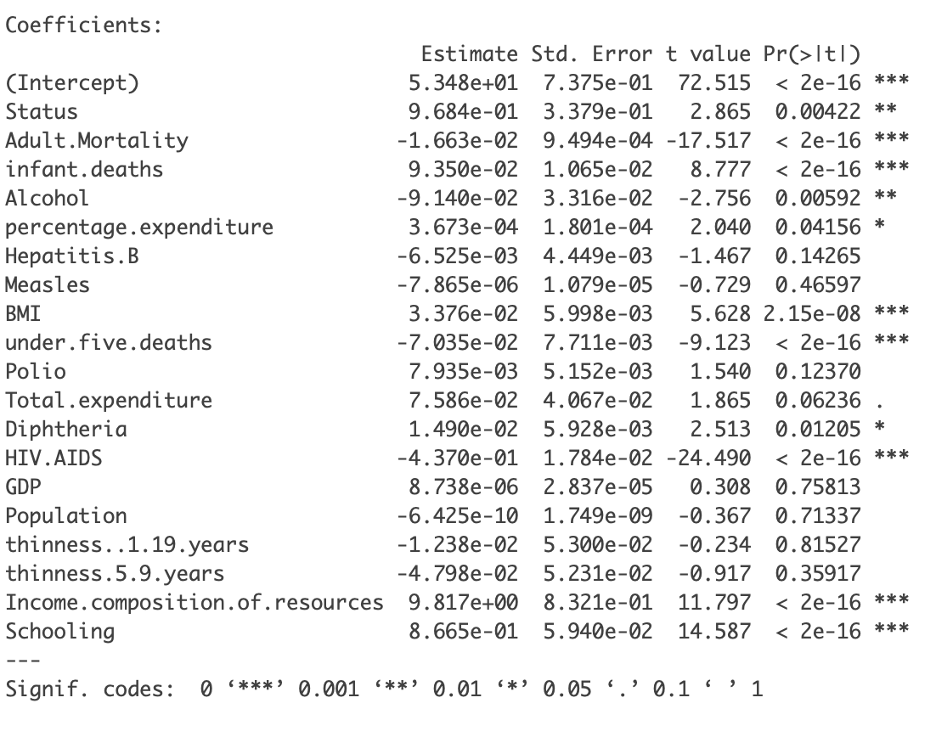
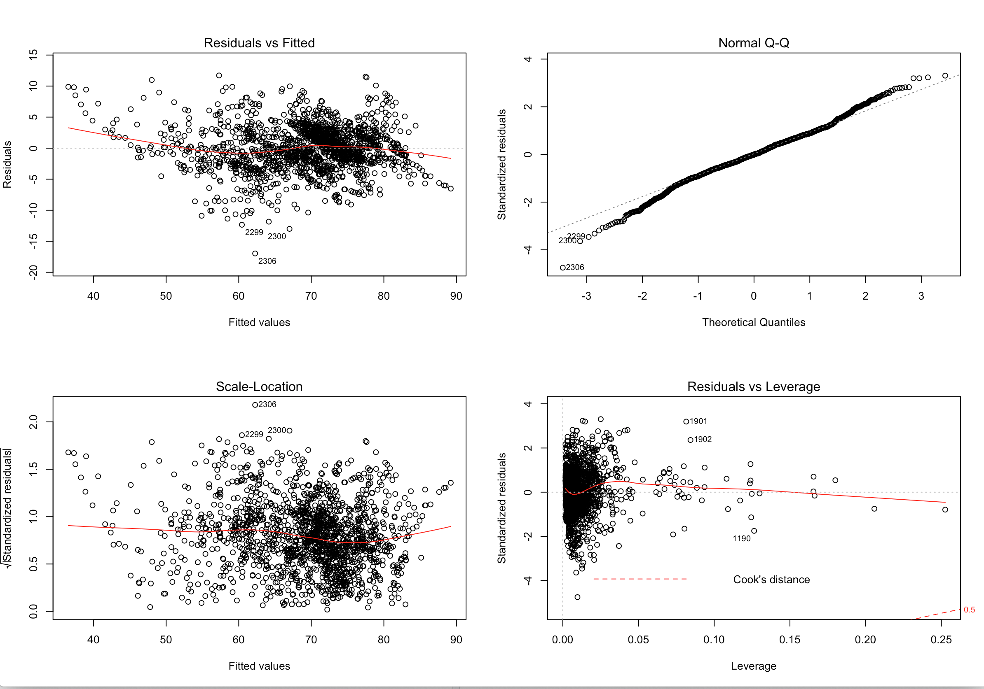
Full Linear Model
Basic linear model
Contains 19 predictors
R^2=83.56%
8 variables are not t-test significant
Each of them is significant individually
Serve as a benchmark

Slide 9
Stepwise Selection
Forward Selection chooses 13 predictor model
R^2=83.51%
Backward and bidirectional Selection produce chooses 15 predictor model
R^2=83.55%
Differences:
Hepatitis.B & Polio

Slide 10
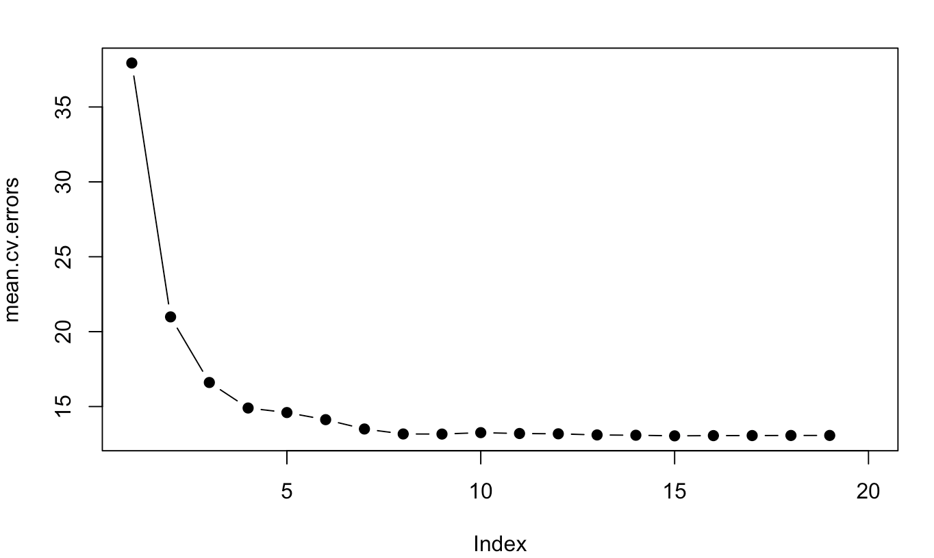
Best Subset Selection
Adjusted R^2 chooses the model with 15 predictors
Same model as backward/bidirectional stepwise selection
Mallow’s Cp chooses the model with 13 predictors
Same model as forward stepwise selection
BIC chooses the model with 9 Predictors
R^2=83.32%
10-fold Cross Validation Test Error across all Predictor Levels

Slide 11
Regularization
LASSO regression
10-fold cross validation
lambda=.0021
Cannot reduce any predictor
Perform very similar to linear regression (full model)
Ridge regression
10-fold cross validation
lambda=.0010
Perform very similar to linear regression (full model)

Slide 12
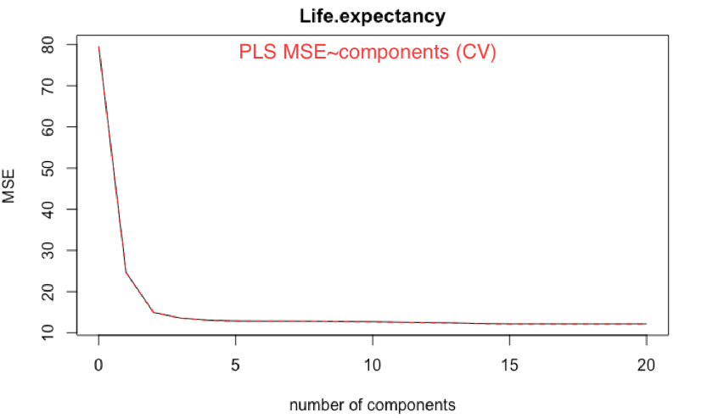
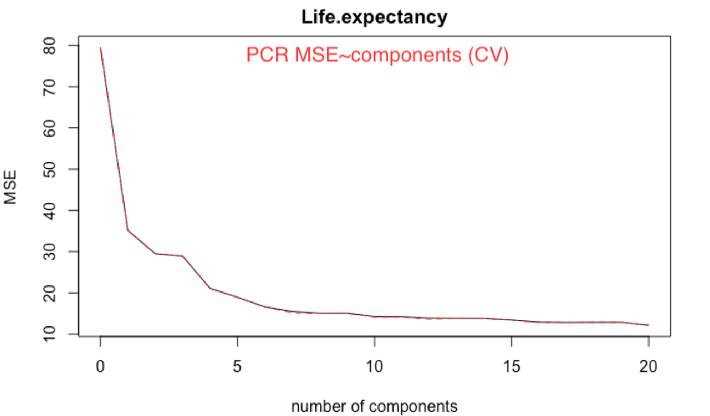
Dimensionality Reduction (PLS & PCR)
To balance the interpretability and model accuracy, I chose:
M=5 in PLS
M=10 in PCR

Slide 13
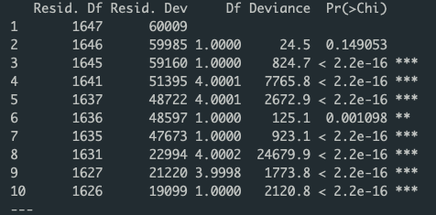
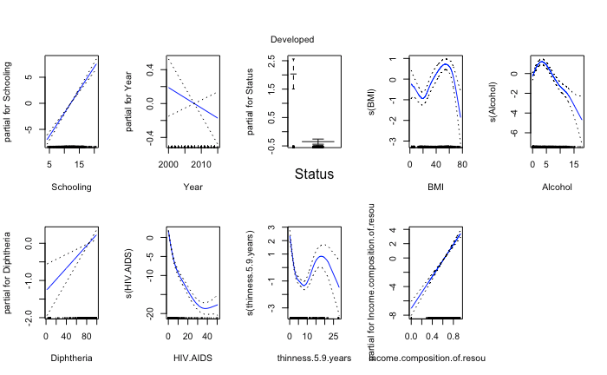
Non-linear model - GAM
Fit 10 CV-chosen variables
ANOVA table:
Only one has relatively low significance
Government expenditure on health
(p = 0.001)
Interesting interpretations:
Scholars live longer
The rich live longer
BMI - very flexible
Alcohol - happy little peak
Immunization (DTP3 vaccine) works!
Notes:
Alcohol, recorded per capita (15+) consumption (in litres of pure alcohol)
Diphtheria tetanus toxoid and pertussis (DTP3) immunization coverage among 1-year-olds (%)

Slide 14
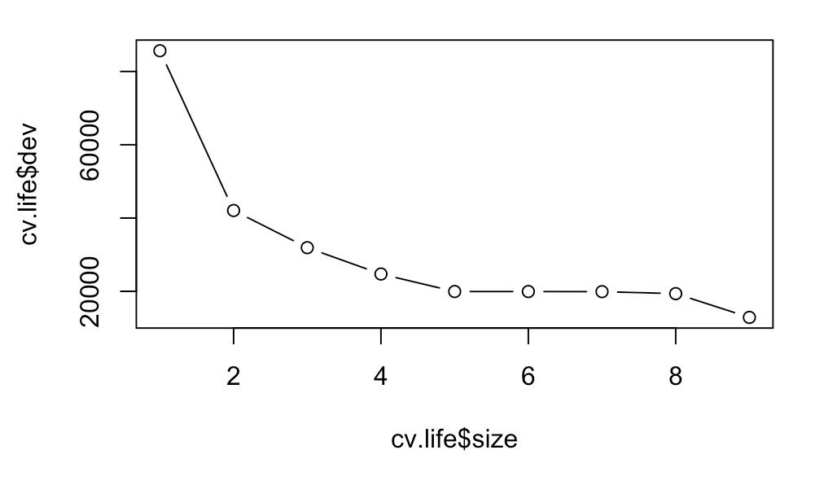
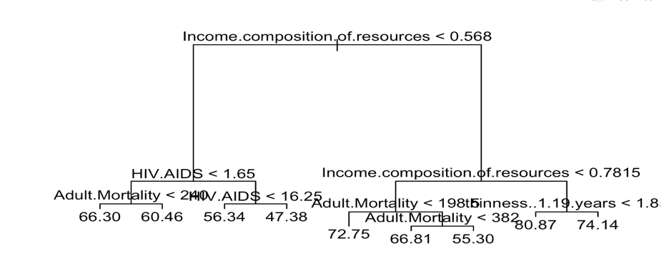
Decision Trees
Four variables used
Cross Validation chose nine splits for optimal pruning
Test MSE around 9.7
Cross Validation for Pruning
Decision Tree Output

Slide 15
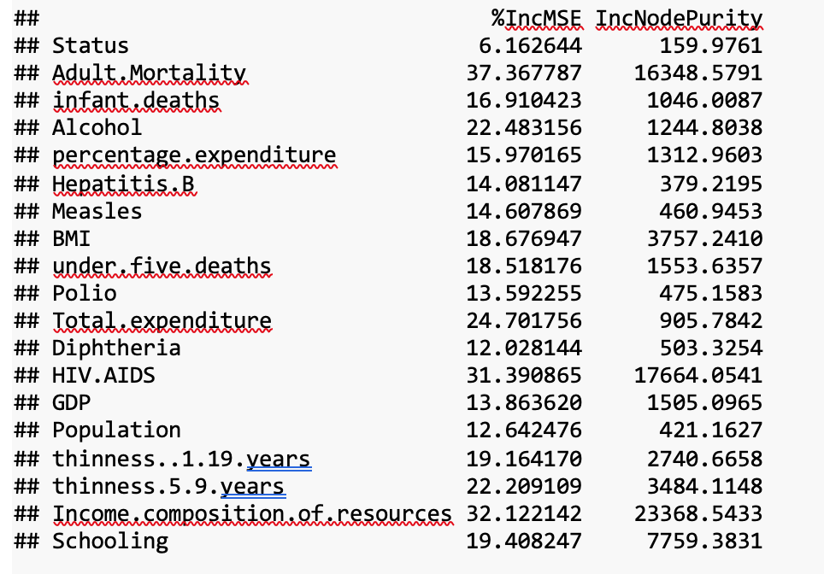
Bagging & Random Forest
Variable Importance Table
For Bagging:
500 bootstrapped trees
Test MSE of 3.6
94.76% variance explained
For Random Forest
Mtry of 6
Test MSE of 3.67

Slide 16

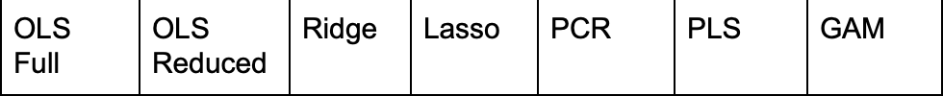
Summary of Results
Test MSE
Lasso and Ridge very similar to OLS
PCR performs the worst
Non-linear GAM has lowest test error
Agreement over important variables
Test R-Squared

Slide 17
Variable Importance
Important Variables:
Percent expenditure on health
Deaths from AIDS
# of years Schooling
Income Composition of Resources
BMI
Adult Mortality (not useful in practice)
Removal of this variable only reduced R^2 by 3%

Slide 18
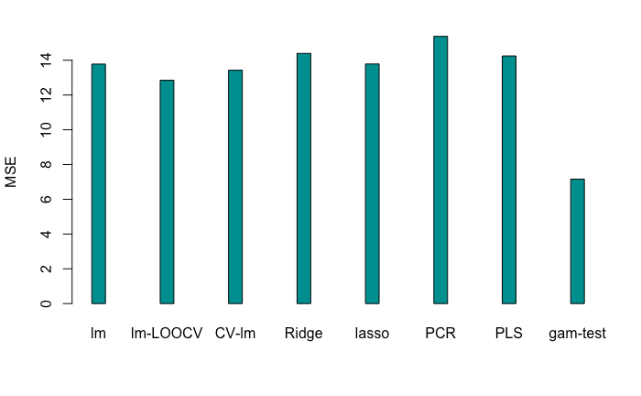
Conclusions
Most models have similar MSE
GAM → Best performance
Most complex
Reduced OLS→ Adequate performance
Best interpretability
Dataset and model account for most factors relevant to life expectancy
Notes:
I changed the GAM test error according to TK’s model.

Slide 19
Implications
To increase life expectancy…
Government Actions
Increase Education rate
Address Economic development
Control spread HIV/AIDS
Invest more on health
Individual Actions
Lower BMI
Take precaution against HIV/AIDS
Educate themselves
Get rich
Notes:
There is not much that the dataset & subsequently the model does not account for that would be relevant to life expectancy in terms of Country infrastructure, etc.

Slide 20

Thank you!
Keep healthy and live long !!

